Slide 1

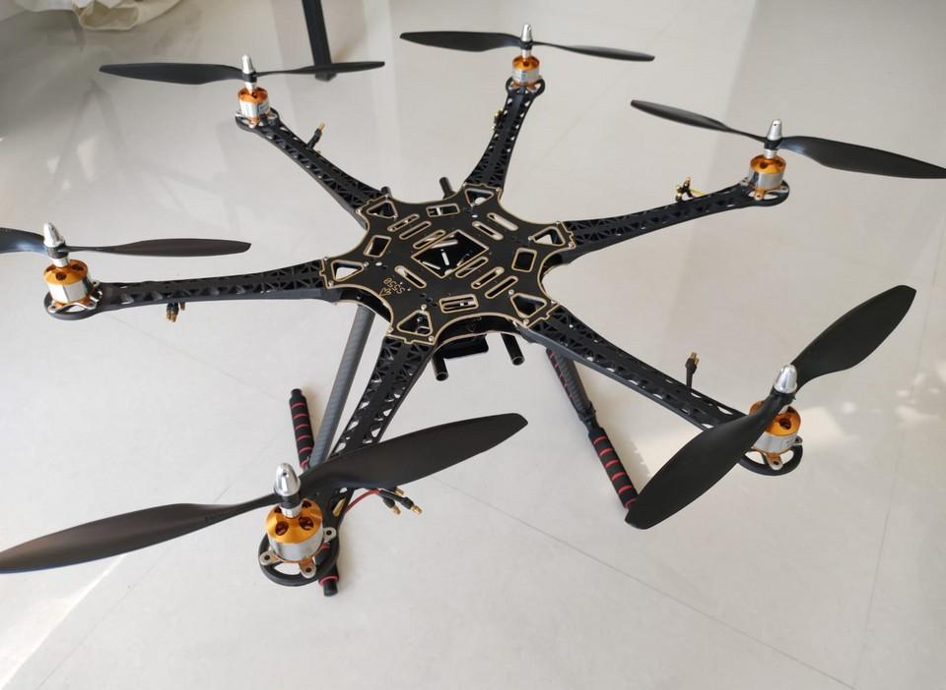
Fire Extinguisher Drone
Title Pgae
Jishnu Pisharody (32)
Probir De (34)
Aditya Rathor (36)
Abhishek Singh (43)
Guided By :- Dr.Bhavin Shah

Slide 2

Title Page
Fire Extinguisher Drone
Introduction
Introduction :-
Fires have led to huge loss of life and property throughout history. Firefighters have to go through many difficult situations while dealing with them.
The system makes use of drones to deliver the fire extinguisher balls into the fire. On coming in contact with fire, the balls explode, putting out the fire.
Drones are flying unmanned robots that can be remotely controlled or made to fly autonomously through software-controlled flight plans in their embedded systems, working in conjunction with onboard sensors.

Slide 3



Title Page
Fire Extinguisher Drone
Literature Survey
LITERATURE SURVEY:-
Burchan et al. (2019) [1] demonstrated the use of Drone assisted wildfire fighting using fire extinguishing balls as a supplement to traditional firefighting methods. The proposed system was a hexacopter with a payload weighing 15 kg and balls of weight 0.5kg each. It consists of scouting unmanned aircraft systems (UAS) to detect spot fires and evaluating the risk of wildfire approach to the building. It also sends the relative data of the firefighting UAS to help them to control the situation.
Abdulla Al-Kaff et al. (2019) [2] developed autonomous UAV for the critical applications of forest fire surveillance. Algorithms implemented into the device to perform surveillance tasks within a specific area, to perform autonomous take-off/landing, trajectory planning and fire monitoring.
Manuj et al. (2019) [3] proposed the use of semi-autonomous drones for firefighting operations rather than putting the life of firefighter at risk. The paper provides information about improvement on the existing hexacopter to obtain stable flight, gather and store Global Positioning System (GPS) data and perform auto- landing.

Slide 4
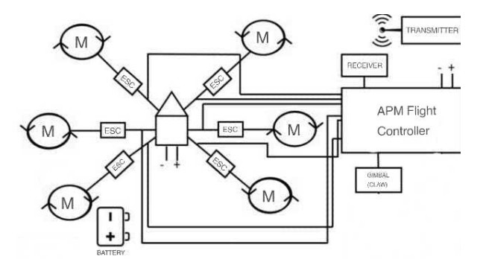
Title Page
Fire Extinguisher Drone
Block Diagram
Block Diagram :-

Slide 5



Title Page
Fire Exntinguisher Drone
Fire Extinguisher Drone
Components:-
Drone Frame (S550) Brushless Motors (1400KV) Propellers
Drone Controller (APM) RC Remote (Flysky)
RC Receivers
Landing Gears
Gripper Arms (Gimbal) Fire Extinguisher Ball Mounts and Joints Screws and Bolts
LiPo Battery

Slide 6

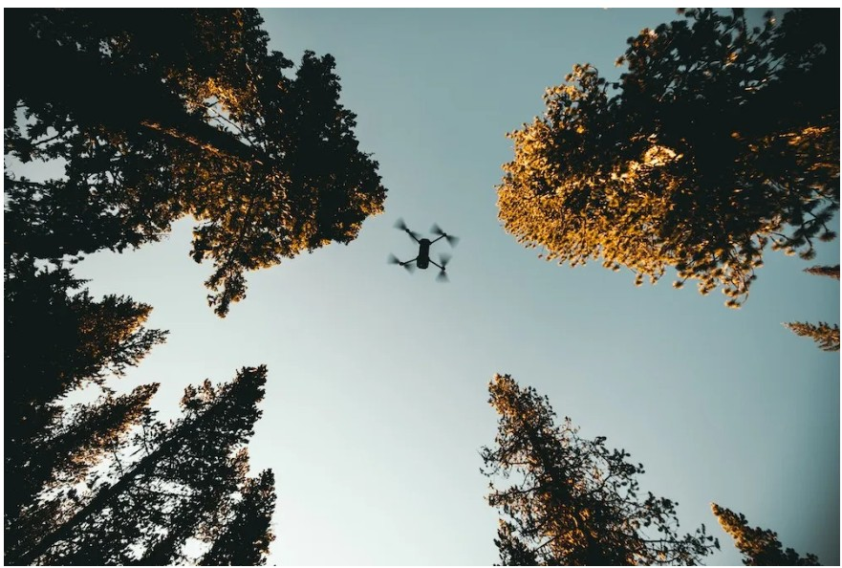







Title Page
Fire Exntinguisher Drone
Fire Extinguisher Drone
ADVANTAGES:-
Unparalleled access.
Risk Assessment.
Emergency Deliveries.
Situational awareness.
Reach difficult places.
Search and rescue.

Slide 7
Title Page
Fire Extinguisher Drone
Fire Extinguisher Drone
Challenges:-
Data collected from multiple drones cannot be stitched together for better situational awareness. Sharing live data becomes difficult, more so when multiple drones are involved.
The flight time for the drone is very less therefore it needs to be dispatched from nearest fire station.

Slide 8

Title Page
Fire Exntinguisher Drone
Fire Extinguisher Drone
Application:-
Situational awareness. Reach difficult places. Search and rescue.
No risk to the life of firefighters. Attain high altitudes easily.

Slide 9

Conclusion:-
Title Page
Fire Exntinguisher Drone
This presentation describes the importance of the Drone in Firefighting operations. The Drone is designed in such a way that it carries a maximum of 5 Kg payload with 15-20 minutes battery endurance.
It reduces the threat to the labor force involved in firefighting operations. Moreover fire departments are seeing large benefits from the use of drones during structure fires and also during any fire-based casualty.

Slide 10
Future Scope:-
Title Page
Fire Exntinguisher Drone
Thermal assessment: In a firefighting situation, firefighters work against the clock to save the lives and integrity of the structure. That is why it is important to direct their efforts towards the source of a fire. Drones equipped with a thermal camera can assist firefighters to identify hotspots inside a blazing structure.
Night Vision: Being able to see in the dark alongside a drone with a night vision camera is a massive advantage. Especially when operations have to be conducted by people, and when this can be done remotely.

Slide 11
Reference:-
Title Page
Fire Exntinguisher Drone
Dr. Ronald T. Wakeham & Dr. John C. Griffith, “Unmanned Aerial Systems in the Fire Service: Concepts and Issues.” JMER,June 2018, eISSN: 2536-8.
Monica Abarca, Carlos Saito, Antonio Angulo, Juan Augusto Paredes and Francisco Cuellar Design and Development of an Hexacopter for Air Quality Monitoring at High Altitudes.
Hassanain, M.A. On the challenges of evacuation and rescue operations in high-rise buildings. Struct. Surv. 2009, 27, 109–118.
Burchan Aydin, EmreSelvi , Jian Tao and Michael J. Starek Use of Fire-Extinguishing Balls for a Conceptual System of Drone-Assisted Wildfire Fighting.

Slide 12

Thank You
Title Page
Fire Exntinguisher Drone
Thank You!

